Slide 1
Universal Response Engine: LLMs for Good
sdmay25-35

Slide 2
Project Overview
Our project aims to develop a comprehensive, multimodal platform to provide support for people in need. That could be physical needs, mental needs, or just guidance during hard times.

Slide 3
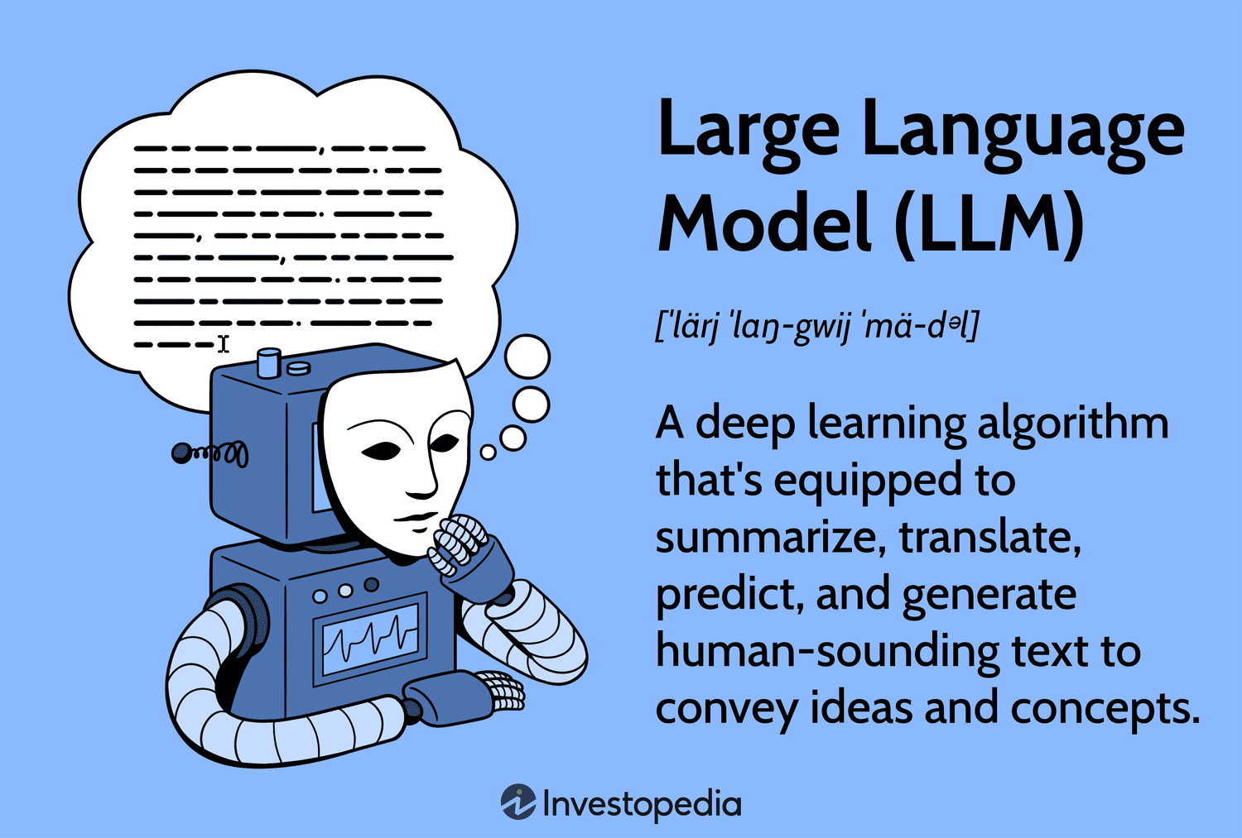

Slide 4
Problem statement
Vulnerable groups of people, such as homeless or displaced individuals, have difficulty accessing essential services and support, especially during crises. This issue arises everywhere across the world, from cities, to suburbs, or to isolated communities. Creating an information hub that provides timely, accurate, and locally relevant resources can greatly help those in need and in many different situations.

Slide 5
Examples of problems

Slide 6
List and description of related products
ChatGPT
Text response generator, not built with purpose of providing support and often gives misleading information
Perplexity
Machine Learning Program that searches the web for answers, gives up to date information, but may provide from untrusted sources.
Google Bard (Gemini)
Generative response program, known to frequently provide false information

Slide 7
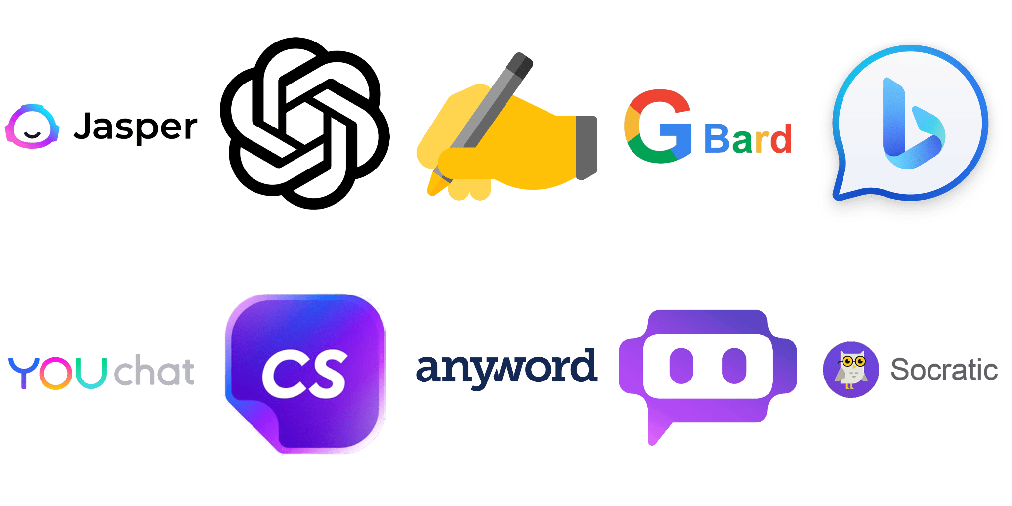

Slide 8
Description of market gap
There is a lot of potential for LLMs to do a lot of good. There aren’t a lot of open source LLMs that are meant for good.
Scope the purpose to providing assistance and resources while providing accurate, accessible information.
Given information will not be held outside of the user session, to retrain the model or otherwise.

Slide 9
New ideas generated by product research
Multimodal input
Sentiment analysis (reading emotion)
Included more coverage

Slide 10
Conclusions
Common Products
Not open source
Not specifically meant for good
Common products store user data to retrain models
Our Product
Open source, meant for good, won’t store user data
Location based for more relevant answers
Concise step-by-step instructions in times of emergency
Notes:
(e.g., how do current ideas compare to existing solutions?)

